Slide 1
Rock Fractures
Ethan Mendel
Brandon Carlisle
Jinyang Chen
Sam Perlmutter

Slide 2
Problem Statement
In the study of geomorphology, it is important to be able to characterize how fractured rock layers are. Currently, identifying the void space of fractures is done manually by hand. This is tedious, as there are several criteria that must be met. It should be more than possible to be able to build a computer vision program to automatically identify and segment the void space of rock fractures.

Slide 3
Proposed Methods
Independent RGB values
Dependent RGB values
Convolution Neural Network
Semantic Segmentation

Slide 4
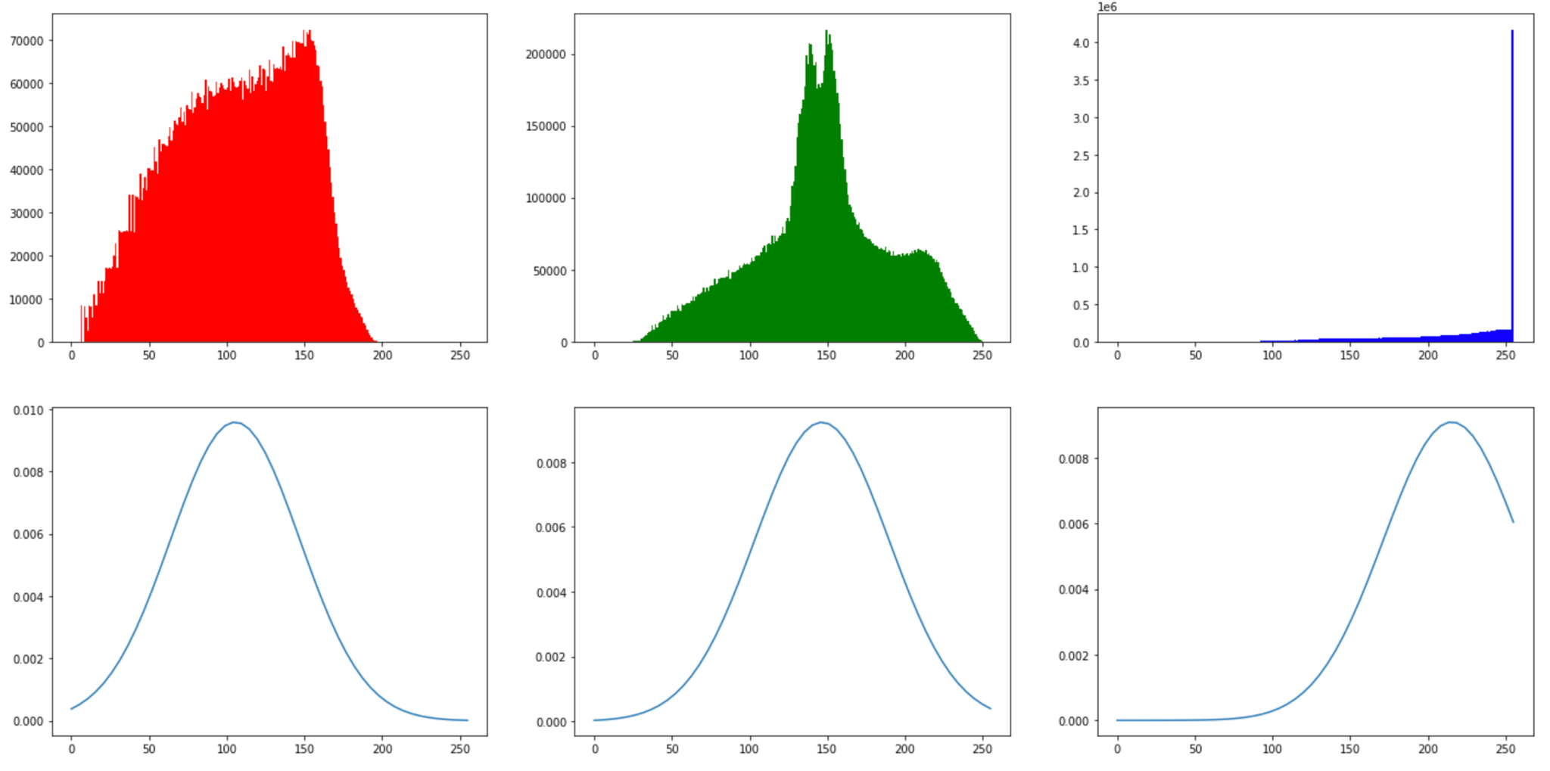
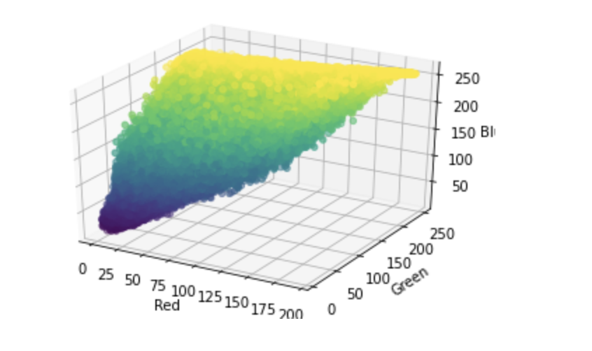
Independent RGBs vs Dependent RGBs

Slide 5
Independent RGB Values
Approach
Collect RGB values
Get independent means and standard deviations
Check if each input pixel is within the accepted standard deviation
X is void space if:
(mean - a*stdev < x < mean+a*stdev) for all RGB mean/stdev

Slide 6
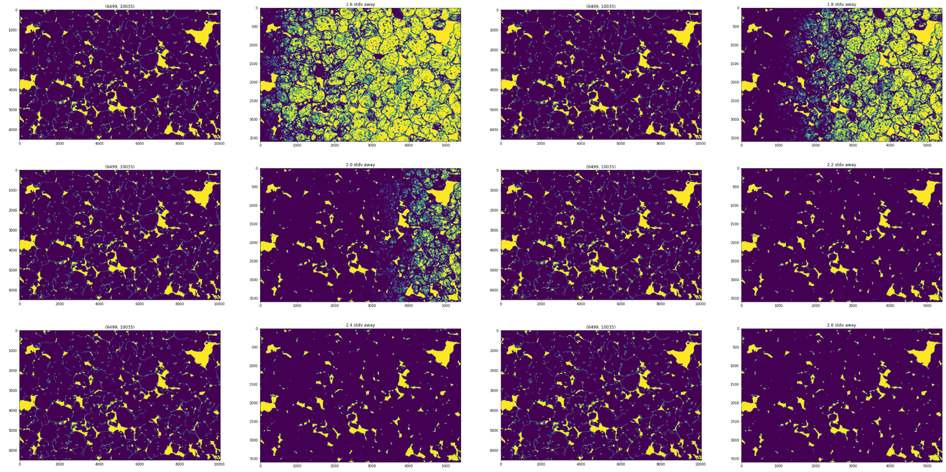
Independent RGB Values
Picking a Standard Deviation

Slide 7
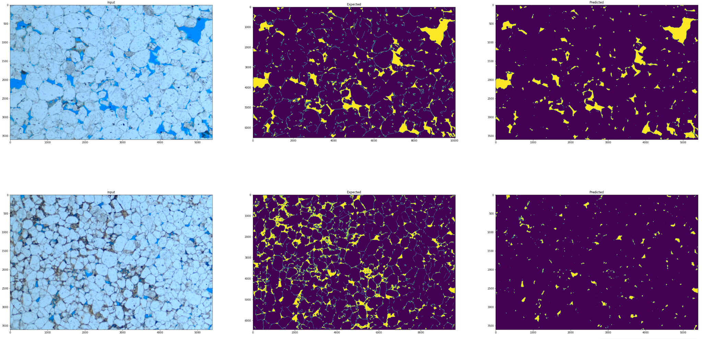
Independent RGB Values
Results

Slide 8
Dependent RGB Values
Approach
Collect RGB values
Save triplets in a list for reference
Check if each input pixel is within the list
X is void space if:
np.array_equals(X,Y) for Y in triplets

Slide 9
Dependent RGB Values
Initial Results

Slide 10
Dependent RGB Values
Second Approach
Collect RGB values
Save triplets in a list for reference
Check if each input pixel is within some range as any in the list
X is void space if:
np.array_equals(X’,Y) for Y in triplets for X’ in possibleX
->an allowance of 1 requires 14 extra triplets to be checked

Slide 11
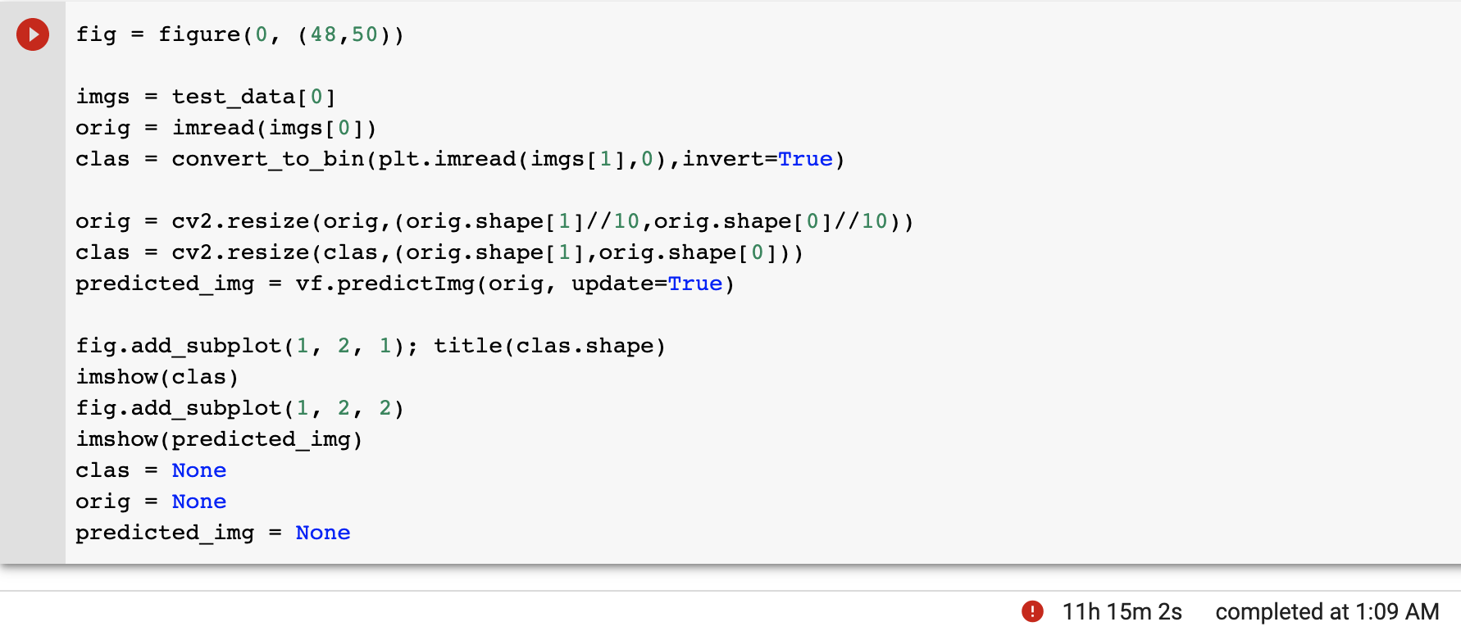
Dependent RGB Values
Results
Notes:
3,600x5,400=19,440,000 pixels to predict
30,000 rgb values
15 checks needed per pixel for an allowance of +-1 for each rgb value
=8,748,000,000,000 (8.7 trillion) iterations to predict 1 image
Just not plausible

Slide 12
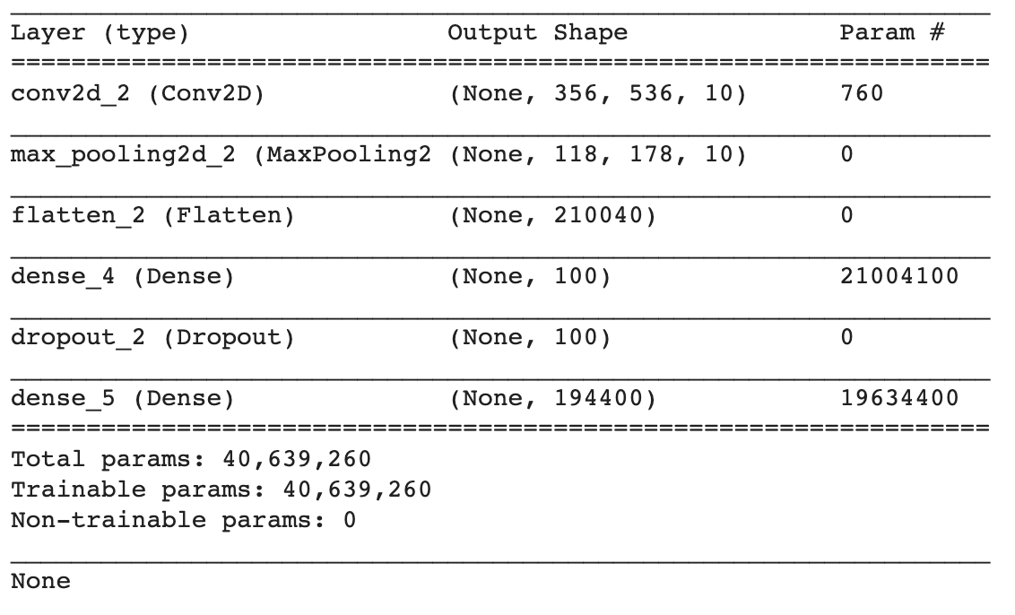
Convolution Neural Network
Approach

Slide 13
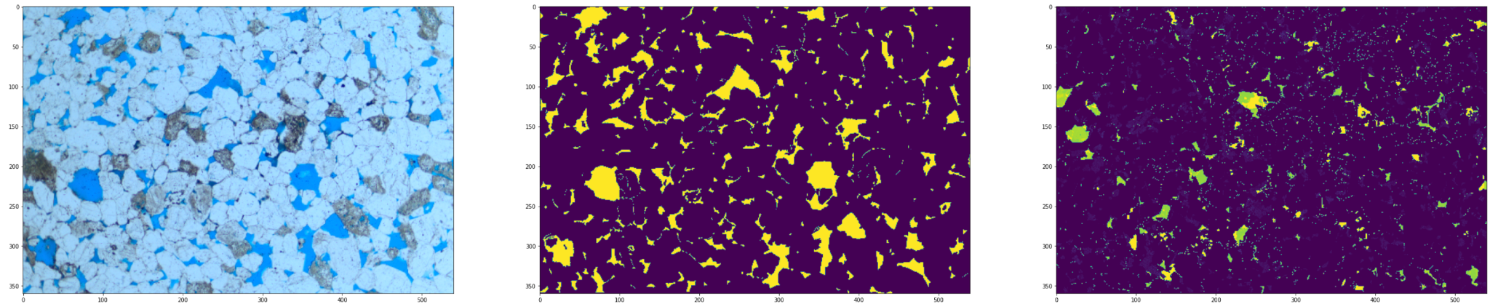
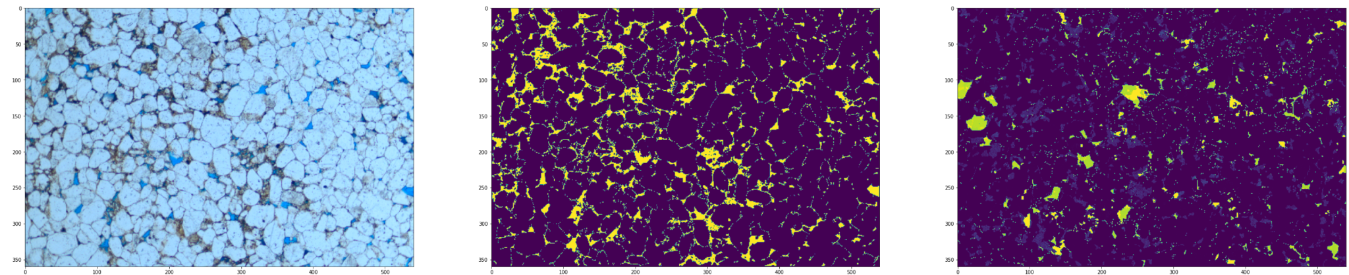
Convolution Neural Network
Results, no validation
Notes:
no batch size, no validation

Slide 14
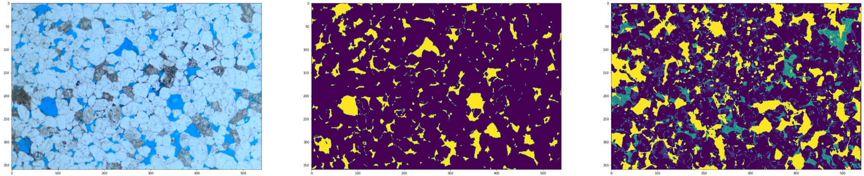
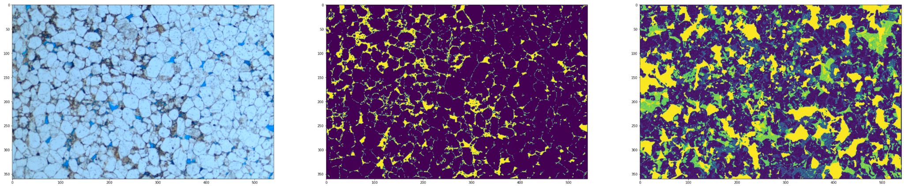
Convolution Neural Network
Results, with validation
Notes:
no batch size, no validation

Slide 15
Semantic Segmentation
Approach
Reorganize data set
Collect FastAI data batches consisting of image and mask
Train a NN
Classes:
0: Rock/Background
1: Fracture

Slide 16
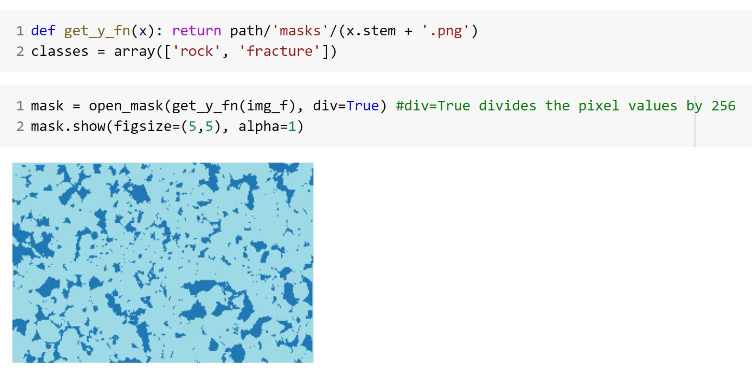
Semantic Segmentation

Slide 17
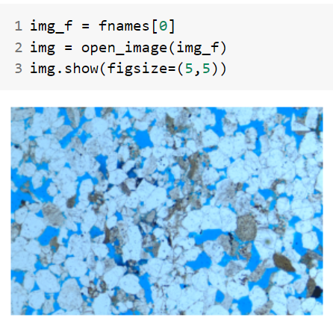
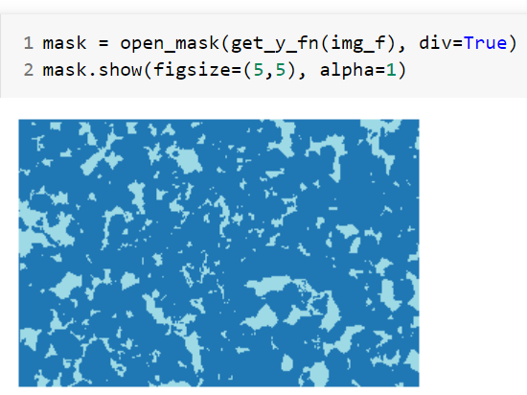
Semantic Segmentation

Slide 18
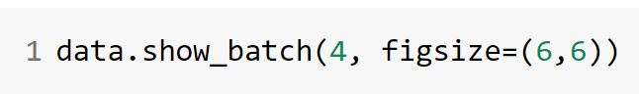
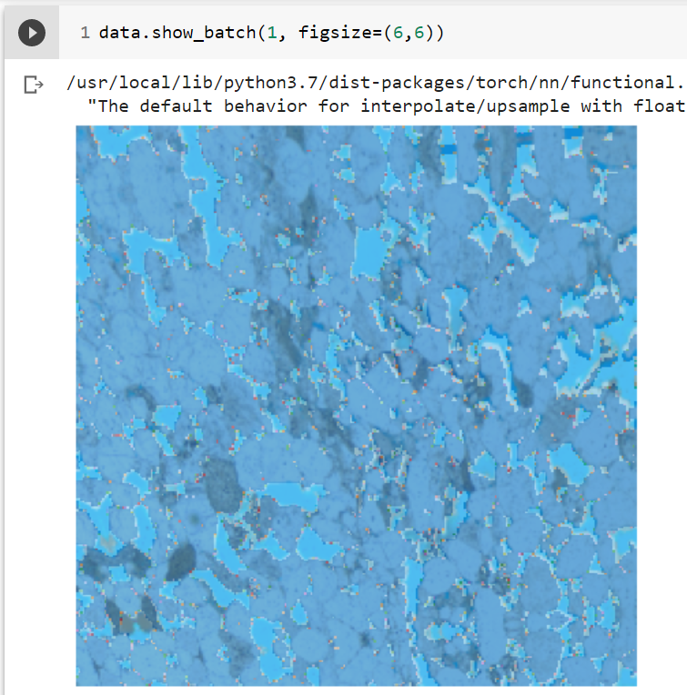
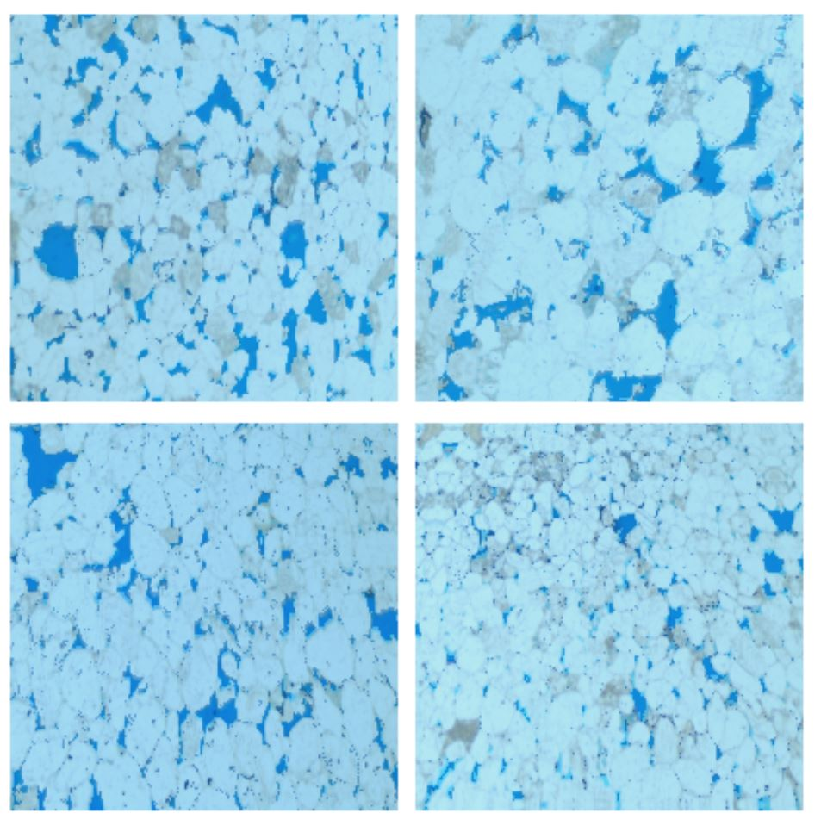
Semantic Segmentation

Slide 19
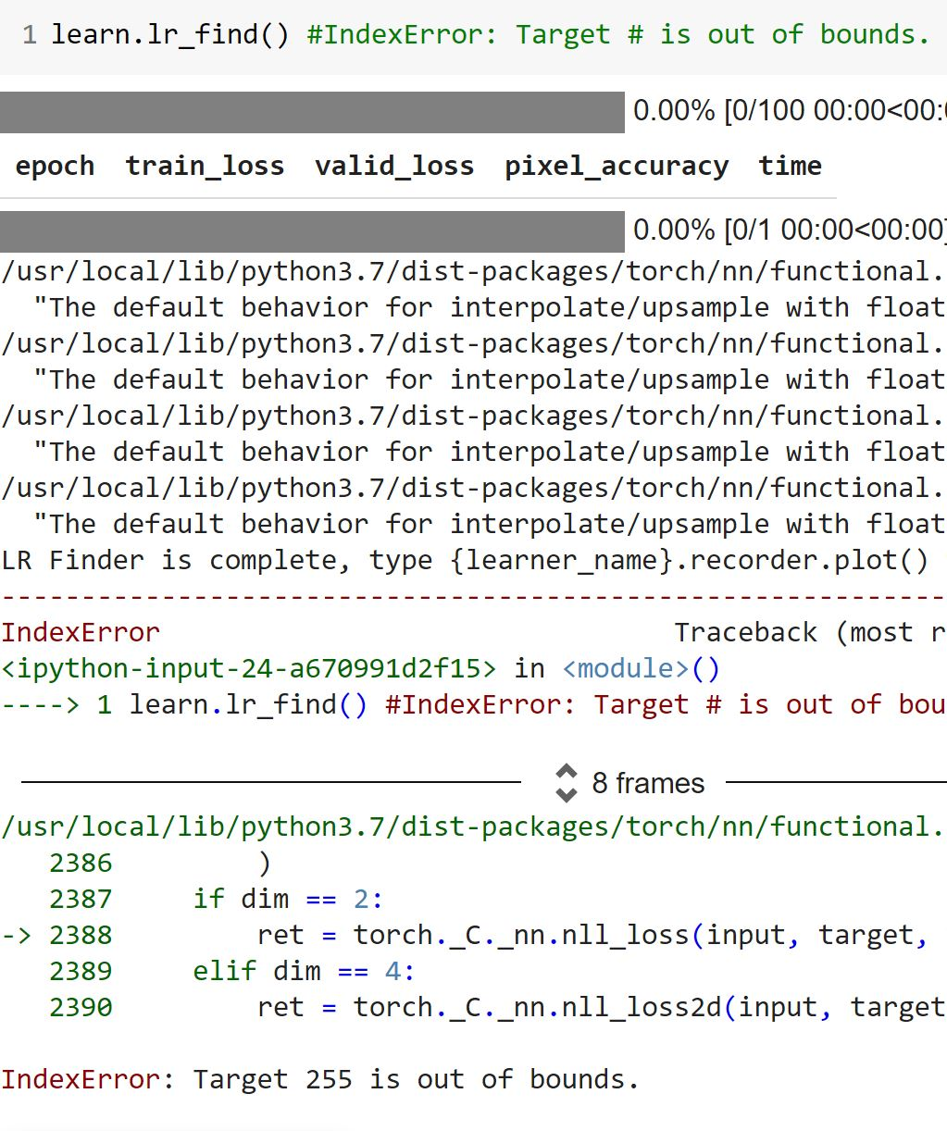
Semantic Segmentation
!

Slide 20
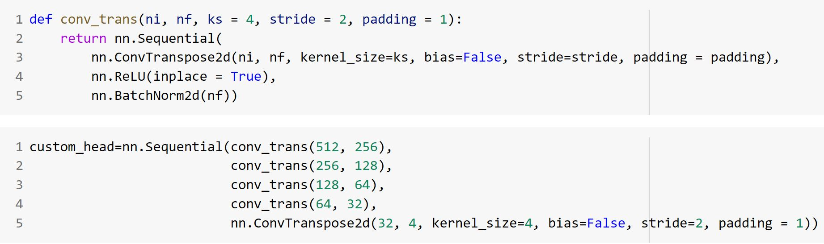
Semantic Segmentation

Slide 21
Semantic Segmentation
Abandoned
Semantic segmentation is a process that can assign specific classes to each pixel of an image
This level of complexity is not required
We only require binary output

Slide 22
Final Approach
Independent RGB Values
K-Fold Validation
Dataset size was limited
Standard Deviation Fitting
To choose a dynamic Standard Deviation
Intersection Over Union (IoU) as a metric
Typically used in image detection

Slide 23
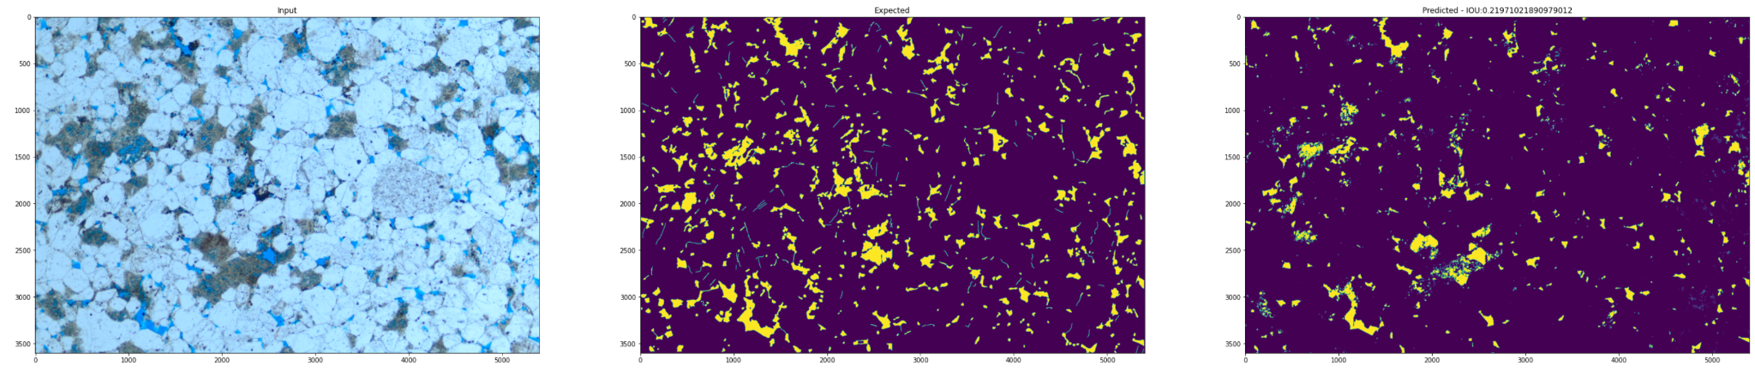
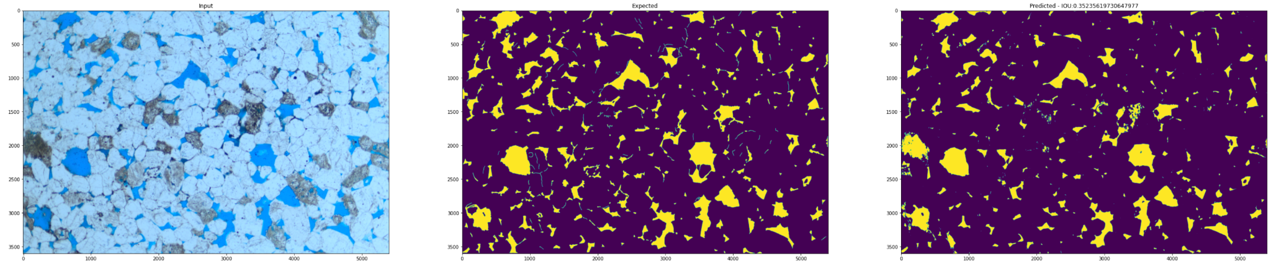
Final Approach
Results

Slide 24
Contributions
Sam Perlmutter - Problem statement and research into open source methodologies
Ethan Mendel - Independent RGB/Dependent RGB/CNN Approaches/Slides
Brandon Carlisle - Semantic Segmentation Approach/Slides
Jinyang Chen - Research into potential customers/businesses and similar solutions

